Slide 1

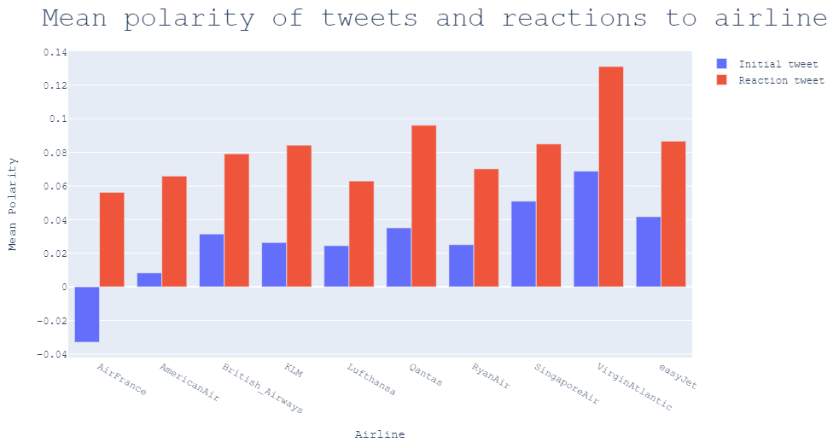
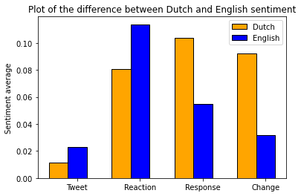
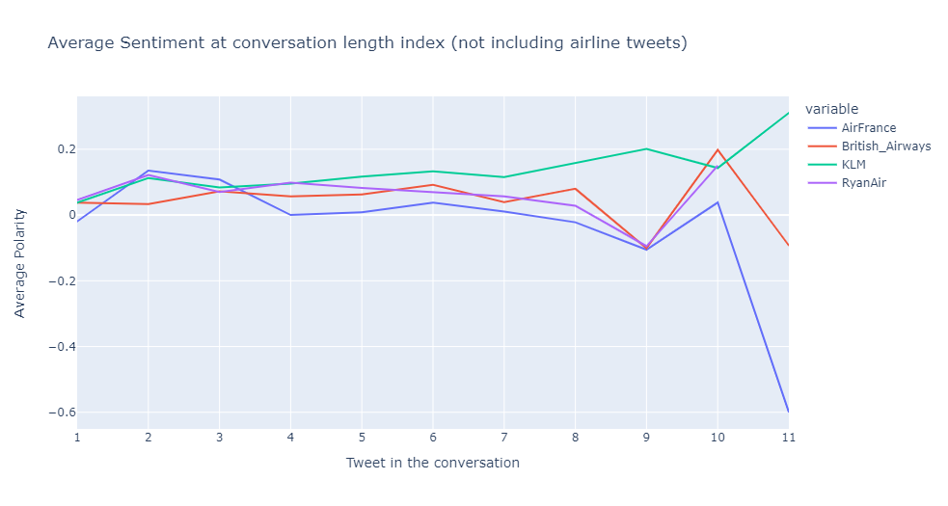
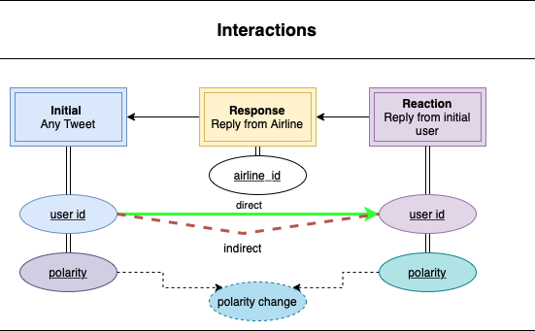
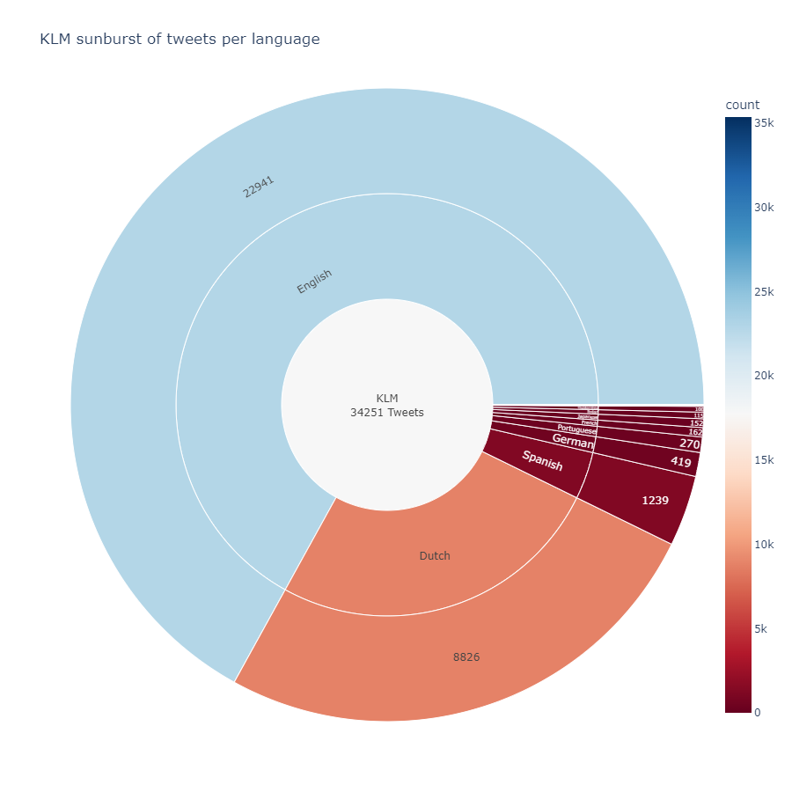
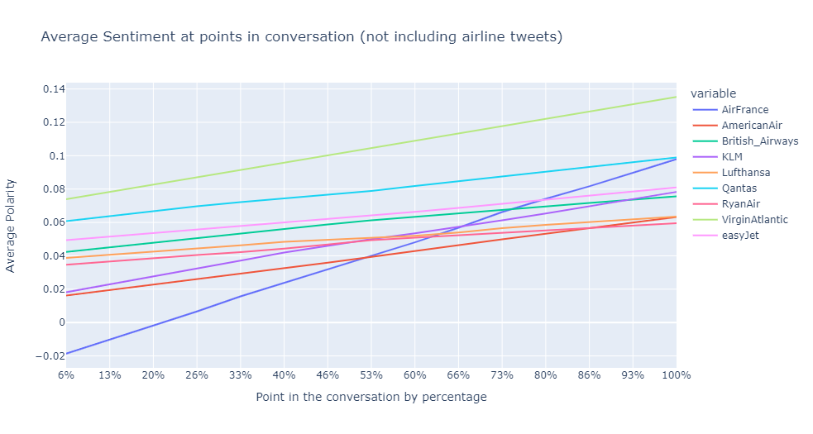
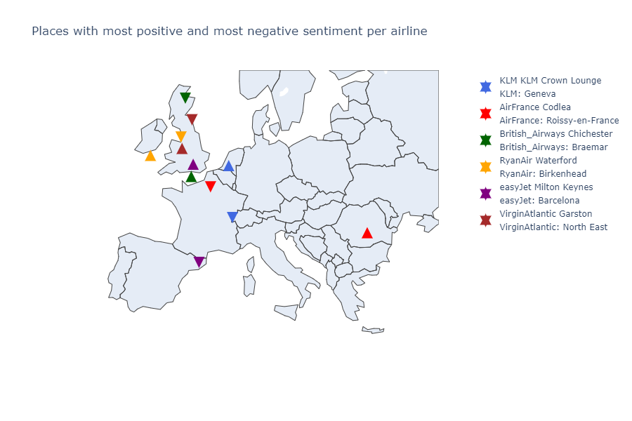
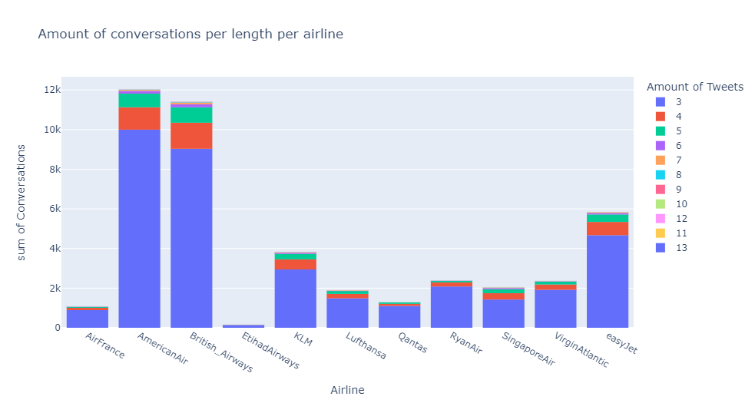
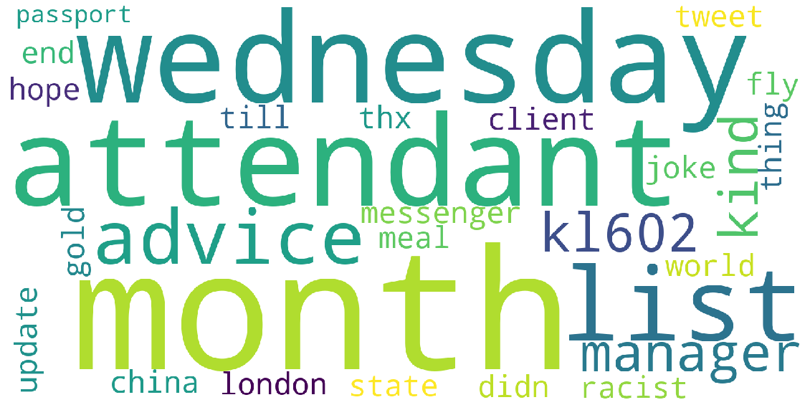
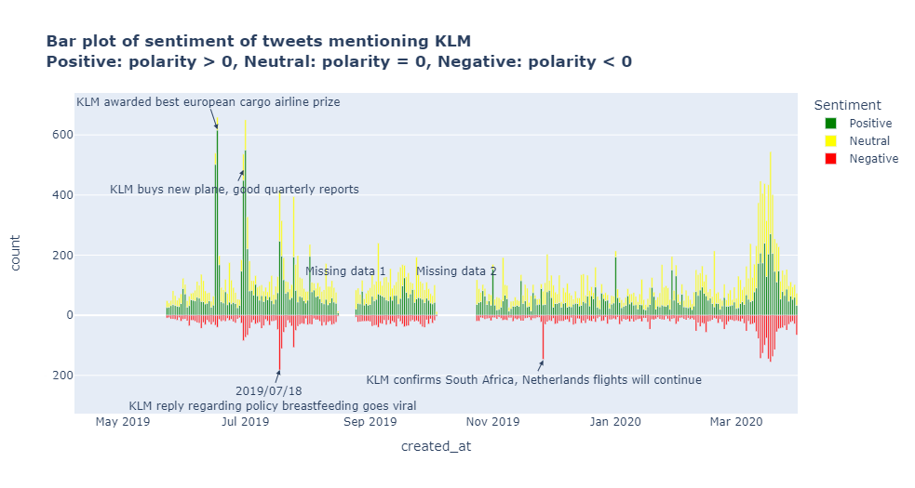
Analysis of KLM’s customer service on Twitter
SENTIMENT ANALYSIS ON TWEETS CONCERNING KLM AND COMPETITIVE AIRLINES
Dennis van Gastel – 1773909; Dorus Hendriks - 1559524; Jesse Beekman - 1755323; Tudor Balba - 1743465; Tijn Wolfs - 1773801
JBG030
INTRODUCTION
Twitter is becoming a bigger social media platform every year and with that companies interact more and more with their customers via this platform. Customer services that used to occur mainly via email or otherwise now largely occur on Twitter. This is also the case for KLM. KLM wants to know how well they are doing on Twitter compared to their competitors and find out if it’s worth it to maintain an active social media presence to improve customer satisfaction.
6 million tweets from May 22nd, 2019, to March 30th, 2020, were stored in an SQL database, splitting the data into 3 tables: tweets, users and places. This reduces the required storage space from 35 to 3.5 Gigabytes. From this data, the sentiment of relevant interactions will be analyzed to give our recommendations to KLM about their Twitter services.
TextBlob rates the sentiment between -1 and 1, with -1 being the most negative and 1 the most positive. Reaction tweets are more positive across the board; initial tweets for KLM are among the least positive
English and Dutch textblob yield similar results; English TextBlob accuracy: 66.8%; Dutch TextBlob accuracy: 62.8%
KLM seems to get better results with sentiment improvement when conversations are longer. However, there aren’t a lot of very long conversations, so this plot could be slightly misleading.
CONVERSATIONS
Direct interactions have same user, indirect have different users
English and Dutch are most relevant for KLM
This plot normalises the length of the conversation to avoid misleading results due to lack of data.
KLM has most conversations; most are 3 tweets long; other airlines have more longer conversations
(legend shows most positive and negative places - in that order - for each airline)
The KLM crown lounge is the place for KLM with the most positive sentiment, while Geneva is the place with the most negative sentiment.
This wordcloud shows words of tweets where the sentiment doesn’t improve when KLM responds. A common theme seems to be that issues with flight attendants (racism etc.) are not very easily solved over Twitter. Also the flight nr. KL602, which flies from Schiphol to LA, seems to be troublesome.
ANALYSIS RESULTS
CONCLUSION
KLM is performing similarly to their competitors on Twitter. Sentiments are very neutral on average and improve very little after KLM’s customer service. However, it would be best to keep the Twitter account active, since the other airlines are doing the same. One piece of advice to KLM would be to avoid redirecting to the regular customer service and try to solve a customer’s problem then and there. A lot of the time customers only turn to the Twitter services after the internal customer services have been unhelpful. To really give any concrete advice to KLM however, we would need data from the internal customer services as well. Only then can we form a definitive opinion on whether the Twitter customer service is effective and if it’s worth maintaining.
Timeline with relevant events for KLM that influenced sentiment; March 2020 is start of first lockdown

Slide 2
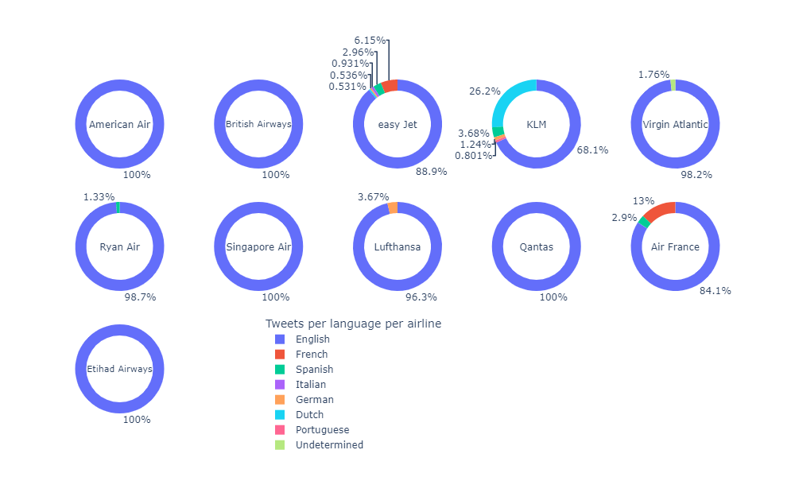
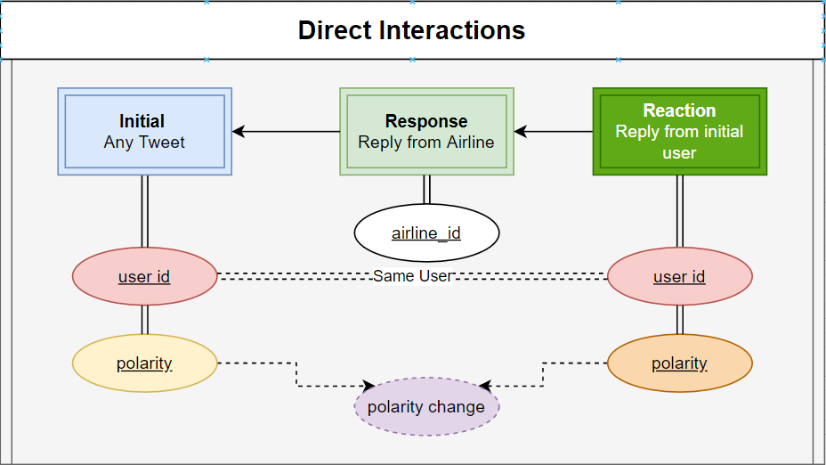
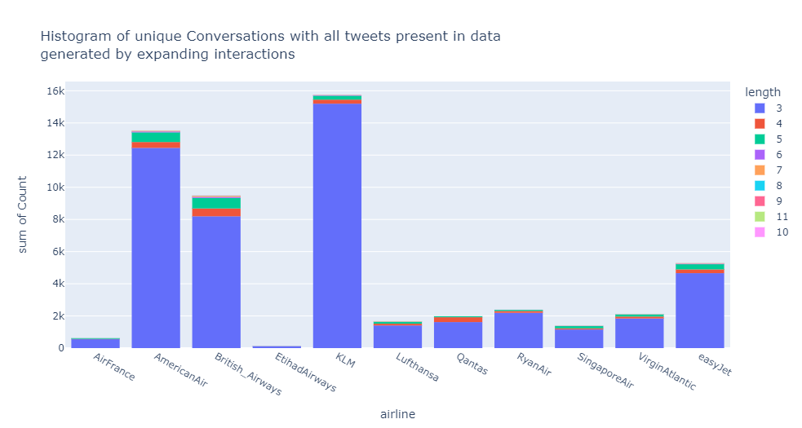
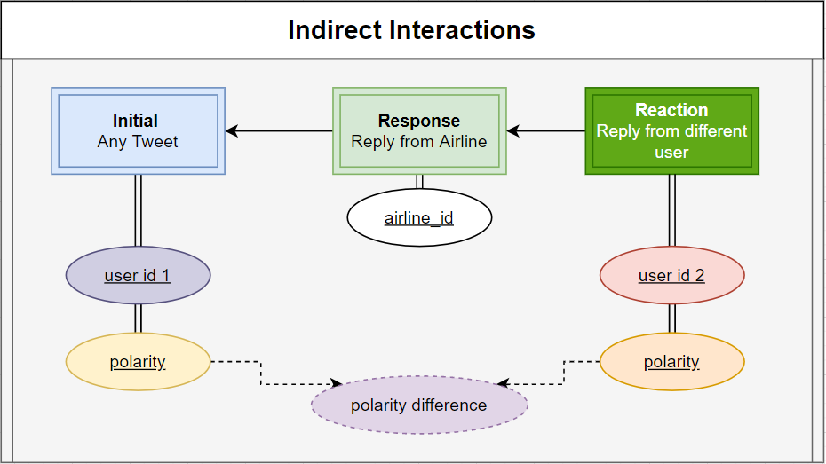
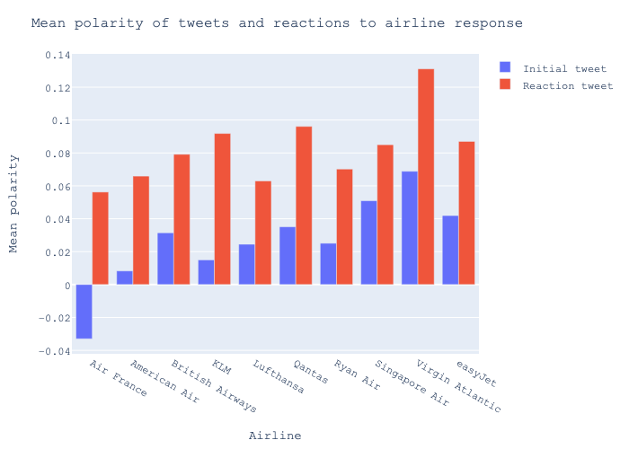
Potential plots for poster
+ everything for extras, polarity over conversations per airline

Slide 3
INTRODUCTION:

